Slide 1
coronavirus Data Engineering Project
Atusa Naseri
Sylvia Lin
Abel H.

Slide 2
Kaggle Data
COVID-19 has infected more than 5000 people in South Korea.
Data Sources :
Patient.csv
Route.csv
Time.csv
Trend.csv (Dataset was added after we combined the first three tables on Wednesday)
https://www.kaggle.com/kimjihoo/coronavirusdataset/data#time.csv

Slide 3
Database Structure

Slide 4
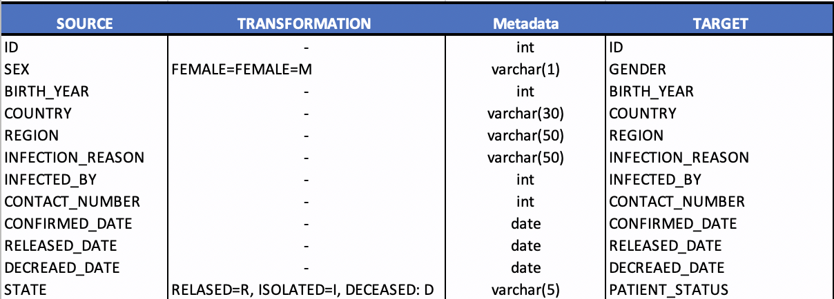
Patient Data

Slide 5
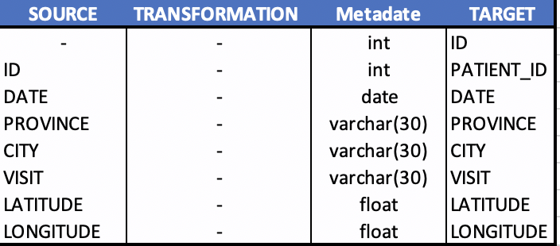
Route Data

Slide 6
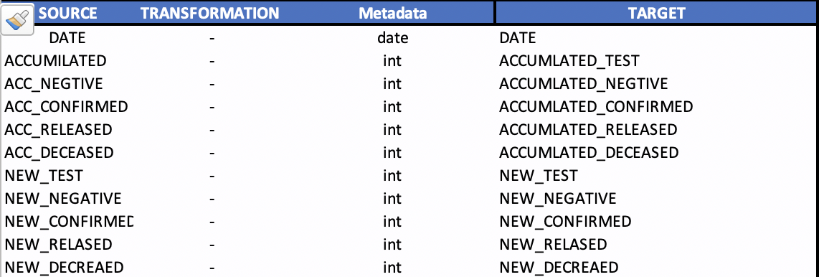
Time Data

Slide 7
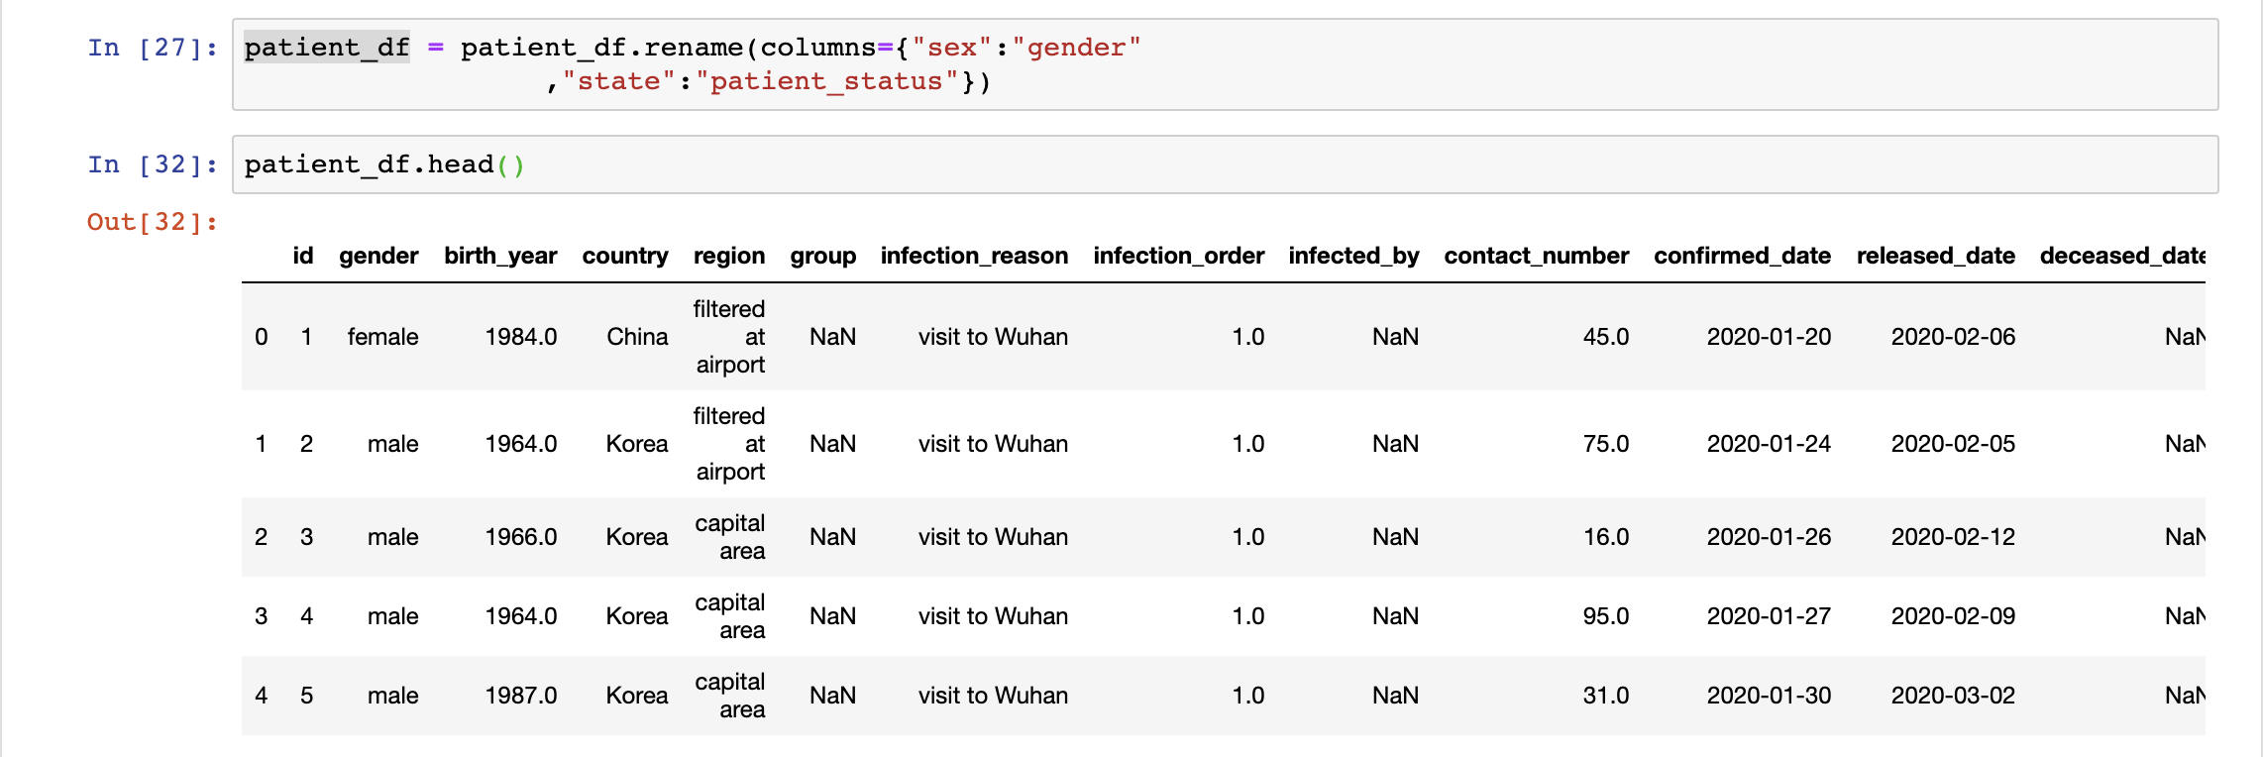
Patient Data Transformation sample

Slide 8
Accumulated Confirmed cases

Slide 9
Confirmed Cases Map

Slide 10
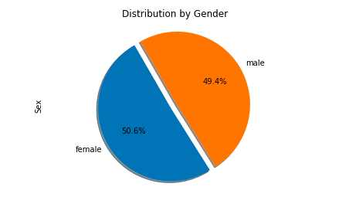
Positive tests by Gender

